Slide 1
COSC 1367: Introduction to Problem Solving using Generative AI
Lecture 1: Introduction
Haibin Zhu
© 2026

Slide 2
Agenda
Me and the Course
I and AI
Complexity
Intelligence
  Abstraction
  Collaboration
Research Innovation/Renovation

Slide 3
The Instructor
Haibin Zhu, PhD
IEEE Fellow, AAIA Fellow, I2CICC Fellow
Professor, Department of Computer Science and Mathematics
Director, Collaborative Systems Laboratory
Nipissing University, 100 College Dr., North Bay, ON P1B 8L7, Canada, haibinz@nipissingu.ca, http://uts.nipissingu.ca/haibinz
Office: A124A
Office hours:

Slide 4
The course
COSC 1367 – Introduction to Problem Solving with Generative AI
Students are introduced in an accessible and interdisciplinary manner to Artificial Intelligence (AI), with a special focus on generative AI technologies such as ChatGPT and DALL·E. Students will examine fundamental AI concepts, real-world applications, and ethical and societal implications. Students from all disciplines can take this course as it requires no prior programming or technical background.

Slide 5



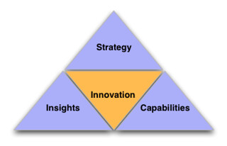
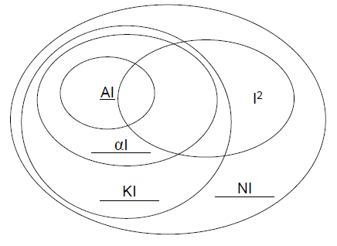
What is intelligence？
Intelligence is all the ability of human beings – Natural Intelligence (NI).
Individual Intelligence (I²).
  Analytical
  Creative
  Practical
Known Intelligence (KI)
Abstract(Expressed) Intelligence (αI).
In general, Emotional Intelligence (EI) belongs to I² but is not considered in current AI.

Slide 6

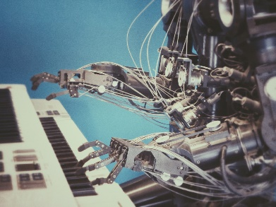
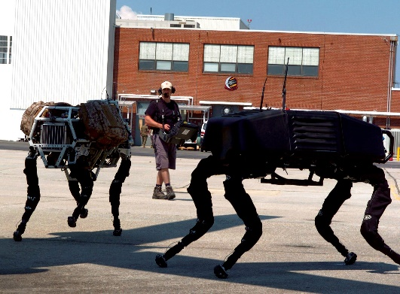
What is AI?
A branch of computer science focused on creating systems and machines that can perform tasks that typically require human intelligence. These tasks include learning, reasoning, problem-solving, perception, understanding natural language, and decision-making. -- Too narrow.
AI is an activity, method, or process to simulate I² using KI.
AI is approaching αI.

Slide 7

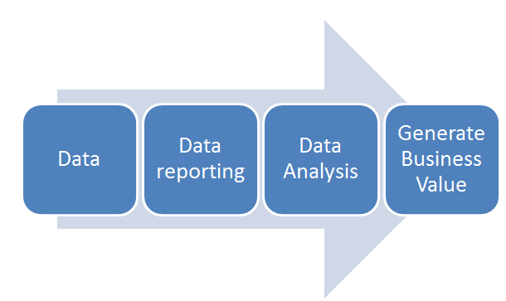

What can AI tools do for us?
1. Routine Data Processing
2. Customer Support
3. Report Writing
4. Programming
5. Data Analysis
6. Financial Services
7. Healthcare and Medicine
8. Manufacturing and Robotics
9. Marketing Plans
10. Self-Driving
12. AI Tutoring
13. Legal Services
14. Human Resources
15. Arts: Drawing and Composition.
f(x) = (x^2-1)/(x^3-5）
https://www.youtube.com/watch?v=6bOklwBi8Ek&list=RD6bOklwBi8Ek&start_radio=1
https://www.youtube.com/shorts/MaIFRfOZ8j8

Slide 8
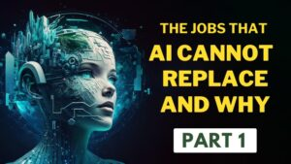

What cannot AI tools do for us?
1. Creativity and Original Thought
2. Emotional Intelligence and Empathy
3. Moral and Ethical Judgments
4. Complex Decision-Making in Unpredictable Situations
5. Physical Interaction in Complex Environments
6. Cultural and Contextual Understanding
7. Human Connection and Trust
8. Ethical and Responsible AI Use
9. Self-Awareness and Consciousness
10. Imagination
m^m= 3125
3125^m = 1/m

Slide 9
NI vs AI: The Creation of Mathematics
"The creation of Mathematics“: not just to doing calculations or solving equations, but to the conceptual invention of mathematical ideas, structures, proofs, and theorems—such as number theory, calculus, or topology. These require deep insight, abstraction, and innovation.
“NI and AI“: how AI compares to human thinking. While AI can perform mathematical computations and even prove theorems, it typically lacks the intentional creativity, philosophical grounding, and sense of purpose behind the original development of mathematics.

Slide 10
AI cannot create
E-CARGO
E-CARGO is a highly abstract model.
E-CARGO is obtained by creative thinking.
E-CARGO is created by computational thinking.
E-CARGO is extracted from fundamental understanding of the human world.

Slide 11
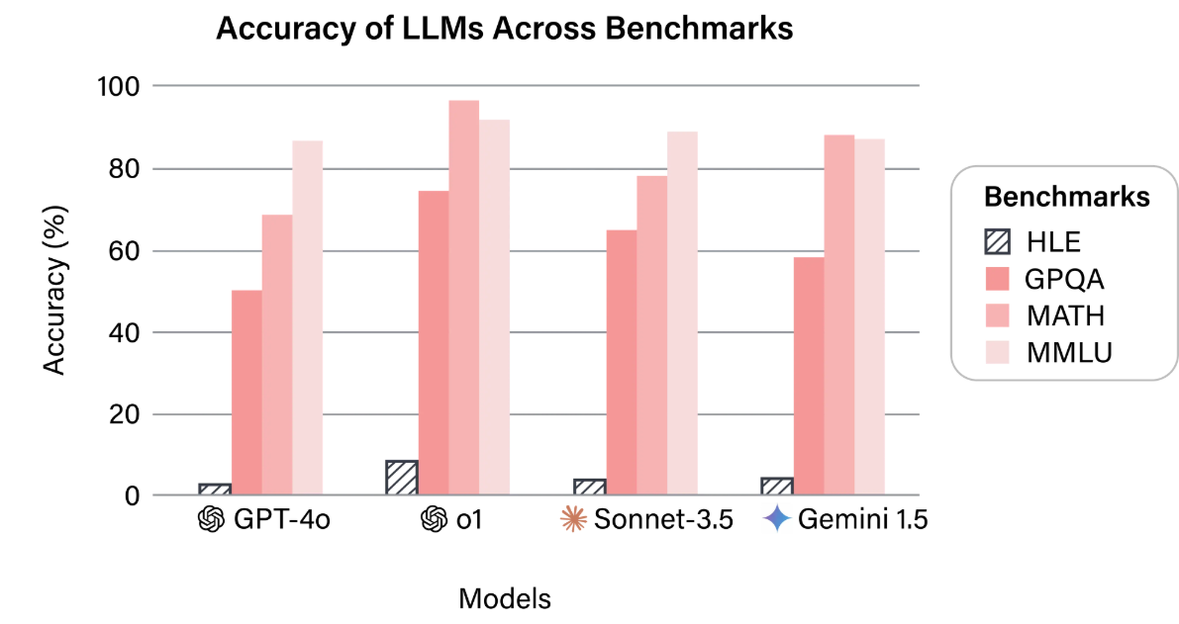
HLE Test (2500 Questions), 04/03/2025

Slide 12
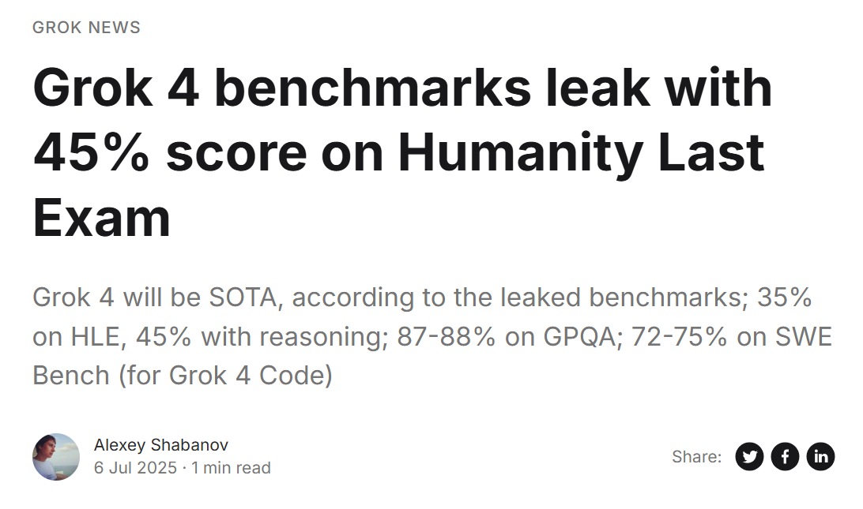

Slide 13
Reason?
1
Complexity!
  The universe/world is complex.
  Intelligence is complex.
    Individual
    Collective (Team)

Slide 14
Reason
2
Humans
  The humans are highly limited.

Slide 15
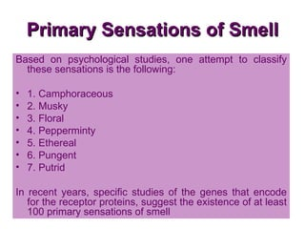
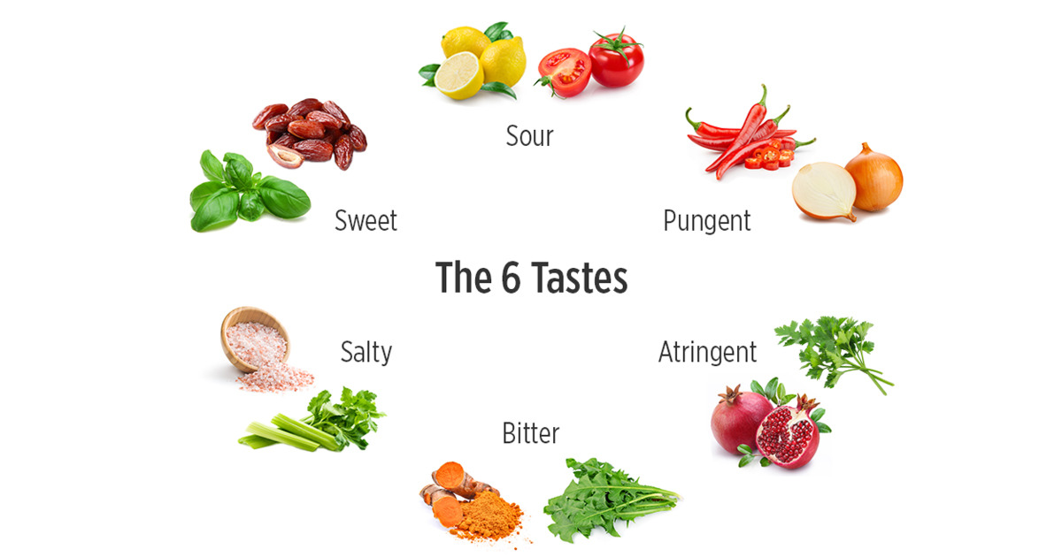

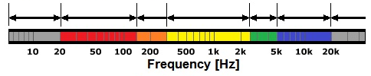

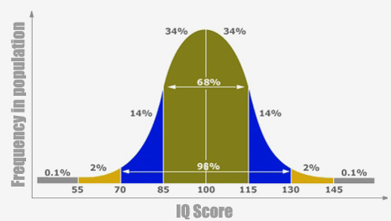
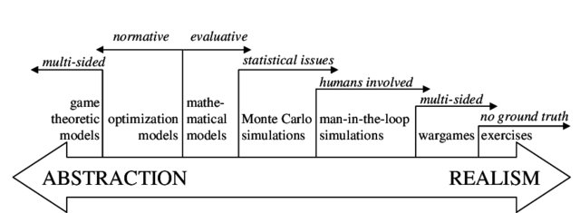
Humans are highly limited!
The Spectrum of Human Ability
infrared
Highly
Limited!!
infrared
Vision:
Hearing:
20 Hz
20 kHz
Voice:
IQ:
Abstract
Ability:

Slide 16
Who will be needed in the AI Era?
Self-driven Researchers/Practitioners
Interdisciplinary Thinkers
Lifelong Learners
Responsible Leadership
Collaboration
Social Responsibility

Slide 17
Mission of Research
A systematic and structured process of asking questions, investigating problems, and generating new knowledge, insights, or solutions.
Problems should be complex.
How to solve the complex problems?
Where to find complex problems?
Wernher von Braun (1912-1977): ″Research is what I′m doing when I don′t know what I′m doing″.

Slide 18
Research Objectives: Solving (Complex) Problems
What are Complex Problems?
1. Those unspecified well
  Argue, explain, convince, and vote.
2. Specified well but searching for a solution is still hard (NP-Hard)
  Hardware:
    Circuits, chips, devices, apparatus, machines,…
  Software:
    Algorithms: Evolutionary + Heuristics
    Or back to 1 needing more specifications.
What?

Slide 19
Research
Data-Based Research
  Real Data-Based Research
    ML
  Assumed Data-Based Research
    Simulation
Non Data-Based Research
  Theoretical and philosophical debate
E-CARGO bridges between
non data-based and
data based research

Slide 20
Innovation vs. Renovation
Innovation creates something new, while renovation improves or revamps something existing.
Innovation is a more disruptive process, involving new ideas, technologies, or markets, while renovation is an incremental process that updates or restores something to a better state.

Slide 21
Feature | Innovation | Renovation
Definition | Creating something fundamentally new or a new way of doing things. | Restoring or improving an existing thing to a better or new state.
Approach | Often involves invention, R&D, and bringing new products or systems to market. | Involves making changes to what is already in place, such as updating a product's features or a building's design.
Scope | Can be a radical transformation that creates new markets. | Typically involves incremental improvements to existing structures, products, or processes.
Examples | Specify a new problem that is normally solved by an humanistic approach, e.g., GRA. | Improve a problem model to specify a new one, e.g., GRA to GMRA.
Goal | To generate greater value and productivity with new solutions. | To maintain competitiveness, improve efficiency, or fix issues in existing offerings.

Slide 22
How?
Problem Specification
+ Find Solutions!
Using
E-CARGO
Where?
Right under your nose

Slide 23
Abstraction/Induction
IQ
A model is an abstraction result.
Abstraction is to extract essential properties from a problem or an object.
A model is aiming to solve the problem and manage a system.
A good model should be concise, keep essentials, expressive, and extendable.
E-CARGO is a model for collaboration/complex systems.

Slide 24
Collaboration: Teamwork
EQ
Collaboration is an activity/process that involves more than one agent to participate in.
To be skilful in collaboration requires a life-long time to learn and practice.
A team is a group of people who are mutually dependent on one another to achieve a common goal.
Without collaboration, there would be no team.
Collaboration ability belongs to human intelligence and it should be supported by AI.
Team Intelligence is still not well investigated.
How Difficult Collaboration is?

Slide 25
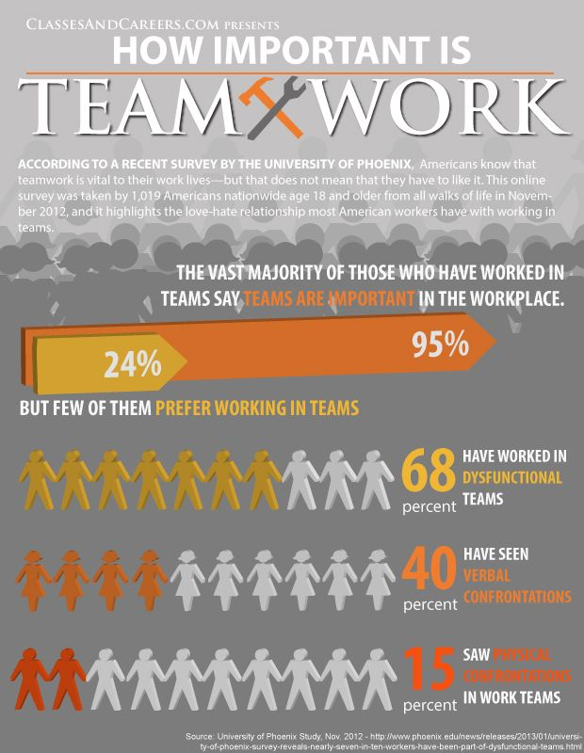
Challenge!
2013 Survey
Required!
Significant!
Interesting!
Valuable!
Complex!

Slide 26
The Nature of Collaboration
Participants play different roles by sharing the common goal and the designated task, where participants can be people, organizations, systems, machines, robots, or autonomous agents.
People play roles by sharing.

Slide 27
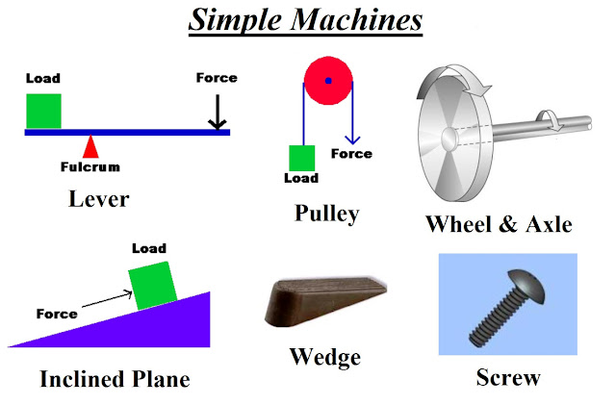
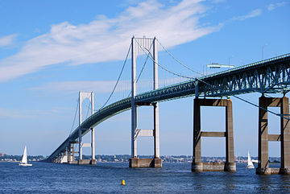


Collaboration made easy/efficient!
-The goal of E-CARGO/RBC
-Through modeling and algorithms

Slide 28



Role-Based Collaboration (RBC)
(Standing on the Shoulders of Giants)
Giants: Object-Orientation, Agent Systems, Distributed systems, Chinese Culture and Philosophy

Slide 29


What is RBC?
Role-based collaboration (RBC)
is
a computational methodology
that mainly uses
to discover, model, formalize, and solve problems
in collaboration and complex systems.
E-CARGO
Roles

Slide 30
Flowchart of
RBC
Creating Roles
Distribution
The users of this chart can be a manager, the BOG of a team, a group of people who hope to collaborate!
(Co-)Operation
Execution

Slide 31


The Model
E-CARGO
E-CARGO
Role-Based Collaboration

Slide 32
The Birth of E-CARGO
Something is between an object and an agent!
∑ ::= <C, O, A, M, R, E, G, s₀, H>
Environments
  Classes
  Agents
  Roles
  Groups
  Objects
Easiness to use
E-CARGO (C,O,A,R,E,G)
The Earth + The People
+ The Society
Agent-Oriented (C,O,A,G) The Earth + The People
Object-Oriented (C, O)
Something is not an object!
1970
1990
2010
Everything is an object!
Time
Notes:
审美三个境界（王国维）：
昨夜西风凋碧树， 独上高楼，望尽天涯路（ 晏殊 ）；
衣带渐宽终不悔，为伊消得人憔悴（ 柳永 ）；
众里寻她千百度，蓦然回首，那人却在灯火阑珊处（ 辛弃疾）。

Slide 33
<C, O, A, M, R, E, G, s₀, H>
Connective thinking reveals systems.
<E, C, A, R, G, O>
Collective thinking reveals E, C, G.
<O, A, R>
Role thinking reveals
objects and agents.
Role-Based
Thinking
Methodology
<R>
Thinking originates from roles.

Slide 34
E-CARGO: An Aesthetic 3-D Model
Agents play Roles by sharing Objects
Role
Agent
A
group (team)
An assignment
A role set
An
environment
An agent set
A raw group
Classes
(An object set)
Object

Slide 35
The views on an agent
A role is the interface for an agent to interact with others.
An agent is playing roles.

Slide 36
A snapshot at a time of interactions of people using E-CARGO
……
……
……
……
……
……
……
……
……

Slide 37
Another viewpoint of people using E-CARGO in a period
……
……
……
……
……
……
……
……

Slide 38
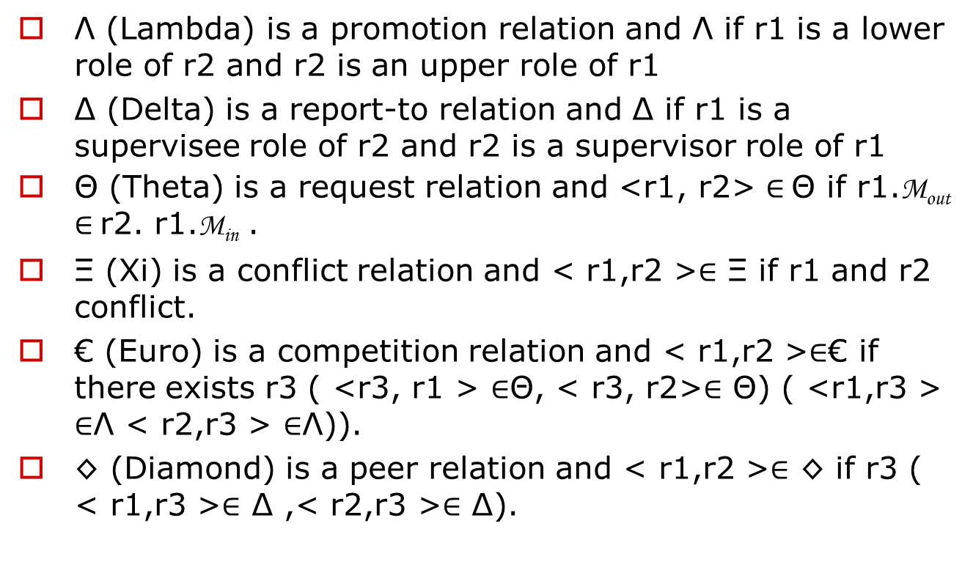
Role Relationships in E-CARGO
Λ (Lambda) is a promotion relation and Λ if r1 is a lower role of r2 and r2 is an upper role of r1
Δ (Delta) is a report-to relation and Δ if r1 is a supervisee role of r2 and r2 is a supervisor role of r1
Θ (Theta) is a request relation and <r1, r2> $∈$Θ if r1.M_{out} $∈$r2. r1.M_{in} .
Ξ (Xi) is a conflict relation and < r1,r2 >$∈$ Ξ if r1 and r2 conflict.
€ (Euro) is a competition relation and < r1,r2 >$∈$€ if there exists r3 ( <r3, r1 > $∈$Θ, < r3, r2>$∈$ Θ) ( <r1,r3 > $∈$Λ < r2,r3 > $∈$Λ)).
◊ (Diamond) is a peer relation and < r1,r2 >$∈$ ◊ if r3 ( < r1,r3 >$∈$ Δ ,< r2,r3 >$∈$ Δ).

Slide 39

E-CARGO explains Shakespeare
All the world’s a stage (E, C, O),
And all the men and women are merely players(A);
They all have their exits and entrances(G);
And one man in his time plays many parts(R).
-----W. Shakespeare , As You Like It, Act II, Scene 7

Slide 40
The Nature of Collaboration Specified using E-CARGO
A GROUP of AGENTS
play different
ROLES
by sharing the
ENVIRONMENT
that is composed of
CLASSES of OBJECTS.
E-CARGO
makes roles
the spirit of a system

Slide 41
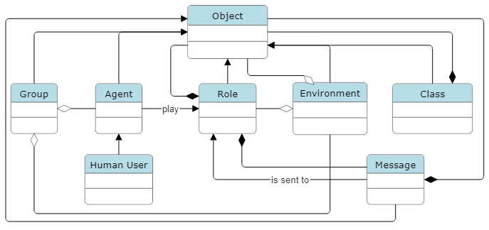
E-CARGO and RBC are integrated and inseparable.

Slide 42
Fundamental Assumptions
Causality: Everything Exists for a Reason
Resource Limitation: Every Resource is Finite
Individualism: Agents Seek to Maximize Their Own Benefits
Collectivism: Collaboration Prioritizes Group Interests
Computational Universality: Everything Can Be Modeled and Computed
Notes:
(事皆有因) (资源有限) (个人贪婪) (集体主义) (皆可计算)

Slide 43
Summary
The greatest is the simplest!
Keep it simple!
Collaboration
=
A GROUP of AGENTS play different ROLES by sharing the ENVIRONMENT that is composed of CLASSES of OBJECTS.

Slide 44
Lab Activity: Project Brainstorming
Form a Team: Join a group of 2 to 5 students.
Brainstorm: Interact with AI tools to explore ideas and identify a problem to solve.
Deliverable for Next Week: Be prepared to report what your problem is and explain why it is significant.

Slide 45
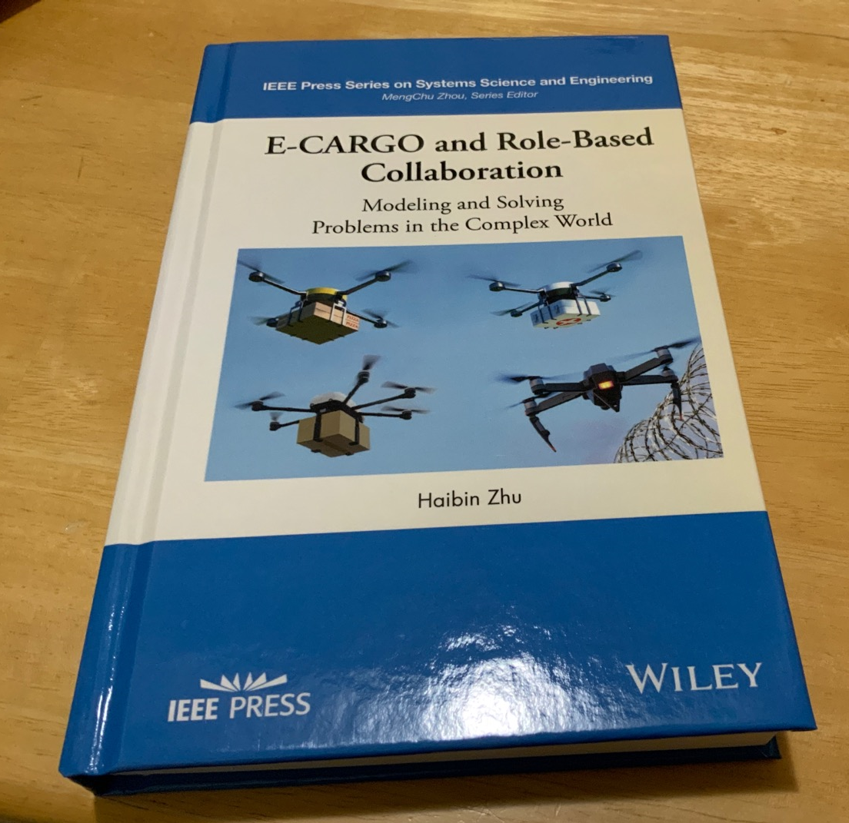
On the market!
https://www.amazon.ca
Search: E-CARGO and Role-Based Collaboration

Slide 46
Question? haibinz@ieee.org haibinz@nipissingu.ca

