Slide 1
COSC 1367: Introduction to Problem Solving using Generative AI
Lecture 3: How to detect AI errors
Haibin Zhu
© 2026

Slide 2
Agenda
Why AI tools make mistakes?
Principles
Examples

Slide 3
Why do AI tools make mistakes?

Slide 4
AI Does Not Truly Understand the World
Current AI systems do not possess genuine understanding, consciousness, or common sense. They learn patterns from large amounts of data and predict what words are likely to come next.
For example, an AI may write:
  "A fish climbed a tree to escape a shark."
  The sentence is grammatically correct, but the AI does not necessarily realize that fish do not climb trees.

Slide 5
AI Learns from Imperfect Data
AI is trained on data collected from the Internet, books, articles, and other sources. These sources may contain:
  Errors
  Biases
  Outdated information
  Contradictory statements
As a result, AI can learn incorrect patterns and reproduce them.

Slide 6
AI Predicts, Rather Than Reasons
Most AI systems are fundamentally prediction machines.
They answer:
  "What is the most likely response?"
instead of
  "What is the correct response?"
A statement can sound convincing while still being wrong.

Slide 7
AI Lacks Complete Common Sense
Humans acquire common sense through years of interacting with the physical and social world.
AI has never:
  Walked on ice
  Driven a car
  Played basketball
  Managed a team
Therefore, it often struggles with practical situations that humans find obvious.

Slide 8
AI Does Not Know What It Does Not Know
Humans can say:
  "I don't know."
AI often attempts an answer even when it lacks sufficient information, leading to hallucinations—confidently stated but incorrect information.

Slide 9
Ambiguous Questions Lead to Wrong Answers
If a question is unclear, AI may guess the user's intention incorrectly.
For example:
  "What is the best programming language?"
The answer depends on:
  AI development?
  Web development?
  Mobile apps?
  Operating systems?
Without context, any answer may be misleading.

Slide 10
AI Makes Mathematical and Logical Errors
Although AI can perform many calculations, it is not a calculator by nature.
It may:
  Miscalculate
  Skip logical steps
  Confuse variables
  Make arithmetic mistakes
especially in complex reasoning tasks.

Slide 11
AI Has Limited Knowledge of Recent Events
Unless connected to current information sources, AI only knows what was available during training.
Therefore:
  New discoveries
  Recent regulations
  Current prices
  Breaking news
may be unknown or incorrect.

Slide 12
AI Cannot Verify Everything
Humans can:
  Perform experiments
  Observe reality
  Consult experts
AI usually cannot directly verify whether a statement is true.

Slide 13
AI Is Not an Expert—It Is an Assistant
AI is like a very well-read student who has read millions of documents but has never lived in the real world.
It can be:
  Extremely knowledgeable,
  Extremely helpful,
  Occasionally brilliant,
but also:
  Overconfident,
  Misleading,
  Incorrect.

Slide 14
Summary
Learn from imperfect data.
Predict rather than truly understand.
Lack common sense and real-world experience.
Sometimes hallucinate information.
Can make logical and mathematical errors.
May misunderstand the question.
Cannot always verify facts.

Slide 15
Principles to Detect AI Errors

Slide 16
The "Too Good to Be True" Principle
If an answer sounds perfect, revolutionary, or magical, be skeptical.
Examples:
  "This AI tool guarantees 100% accuracy."
  "This algorithm solves all NP-hard problems instantly."
  "You can lose 50 pounds in one week."
Extraordinary claims require extraordinary evidence.

Slide 17
The Reality Check Principle
Ask:
  Does this answer make sense in the real world?
Example:
  AI says:
  "A drone can deliver 1,000 kg of cargo for 500 km."
How much energy is needed?
What is the payload of existing drones?

Slide 18
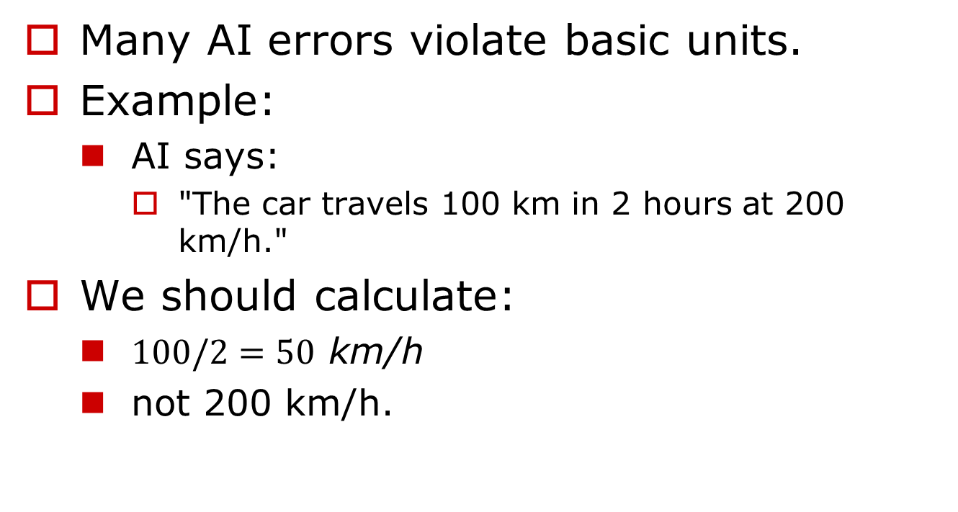
The Unit Check Principle
Many AI errors violate basic units.
Example:
  AI says:
    "The car travels 100 km in 2 hours at 200 km/h."
We should calculate:
  $100/2=50\text{ km/h}$
  not 200 km/h.

Slide 19
The Extreme Case Principle
Test the answer at extreme values.
Example:
  AI says:
  "Adding more workers always increases productivity."
Ask:
  What if 1,000 workers share one keyboard?

Slide 20
The Consistency Principle
Check whether the answer contradicts itself.
Example:
  AI writes:
    "The company was founded in 2010."
    Later:
    "The company operated successfully in 2005."
  Contradiction detected.

Slide 21
The Source Principle
Ask:
  Where does this information come from?
We should distinguish:
  Facts
  Opinions
  Assumptions
  Hallucinations

Slide 22
The Common Knowledge Principle
We should know a core set of facts:
Examples:
  Canada is in North America.
  The Earth orbits the Sun.
  2 + 2 = 4.
  Water freezes near 0°C.
If AI contradicts common knowledge, investigate.

Slide 23
The Probability Principle
Ask:
  Is this likely?
Example:
  AI says:
    "Every student in the class received 100%."
    Possible?
    Yes.
    Likely?
    No.

Slide 24
The Expert Principle
If the answer affects:
  health,
  law,
  finance, and
  engineering safety,
We should verify with experts or authoritative sources.

Slide 25
A Practical Checklist
Before trusting AI, ask:
  Does it make common sense?
  Are the numbers reasonable?
  Are the units correct?
  Is the answer internally consistent?
  What evidence supports it?
  What assumptions are hidden?
  What happens in extreme cases?
  Does it contradict known facts?
  Is it likely in the real world?
  Would I trust this answer if my life depended on it?

Slide 26
Examples

Slide 27
Solve 3125^m = 1/m
Answer m = 1/5.
Correct Solution:
  3125^m = 1/m
  3125 = (1/m)^(1/m)
  5^5 = (1/m)^(1/m)
  5 = 1/m
  m = 1/5

Slide 28

Question? haibinz@ieee.org haibinz@nipissingu.ca

