Slide 1
COSC 1367: Introduction to Problem Solving using Generative AI
Lecture 4: How AI Works
Haibin Zhu
© 2026

Slide 2
Learning Objectives
By the end of this lecture, you will be able to:
  Explain the difference between AI, Machine Learning, and Deep Learning
  Describe how neural networks process information layer by layer
  Understand how AI models are trained using data, loss functions, and optimization
  Identify the key components: parameters, weights, activations, and gradients
  Recognize different types of AI architectures (CNNs, RNNs, Transformers)
  Critically evaluate what AI can and cannot do
  Discuss ethical implications and societal impact

Slide 3
What is AI?
Artificial Intelligence (AI):
  The ability of machines to perform tasks that typically require human intelligence.
Examples:
  Spam filters in email
  Netflix recommendations
  Siri / Alexa voice recognition
  Google Maps route optimization
  Autocorrect and predictive text
  Facial recognition to unlock your phone
Key Insight:
  AI is not "thinking." It is pattern recognition at massive scale.

Slide 4
Ai Architecture
Artificial Intelligence - Broad field (since 1950s)
  Machine Learning - learns from data
    Deep Learning - neural networks
      Transformers - Current state-of-the-art

Slide 5
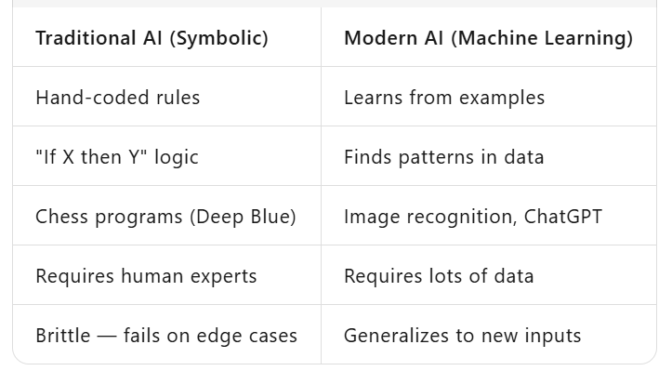
Two Types of AI

Slide 6
What Is Machine Learning?
Definition: A computer program is said to learn from experience E with respect to some task T and performance measure P, if its performance at task T improves with experience E. — Tom Mitchell, 1997
Instead of writing explicit rules, we feed the computer data and let it figure out the rules itself.

Slide 7
AI - Recipe
Collect data (examples)
Choose a model architecture
Train the model (adjust internal settings)
Test on new data
Deploy

Slide 8
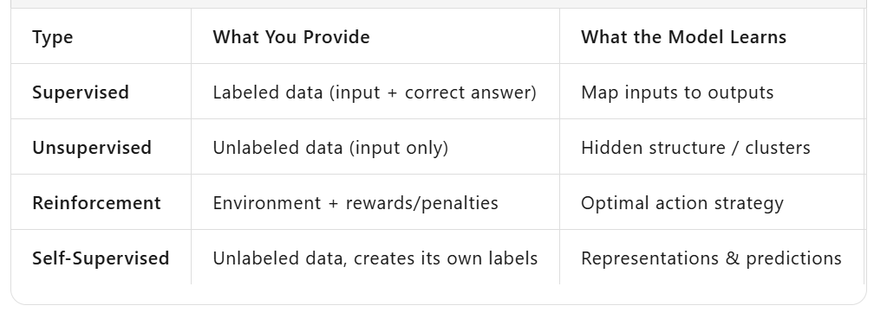
Types of Machine Learning

Slide 9
The Core Idea: Functions
At its heart, AI is just finding a function:
  Input (x) → [Model f(x)] → Output (y)
Examples:
  x = image of a cat → f(x) = "cat"
  x = "How are you?" → f(x) = "I'm doing well, thanks!"
  x = house features → f(x) = predicted price ($450,000)
The challenge: We don't know f(x). We have to discover it from data.

Slide 10
Activity — Guess the Function (3 min)
Input (x) | Output (y)
2 | 4
3 | 6
5 | 10
7 | ?
Input (x) | Output (y)
"happy" | 😊
"sad" | 😢
"angry" | 😠
"excited" | ?
Answer: y = 2x
This is exactly what ML does — but with millions of examples.

Slide 11
From Functions to Neural Networks
How do we represent a complex function?
  Option 1: Write it down mathematically
  → Impossible for "recognize a cat in a photo"
  Option 2: Use a neural network — a flexible, trainable function approximator
  → This is what we do
The Universal Approximation Theorem: A neural network with enough neurons can approximate ANY function.

Slide 12
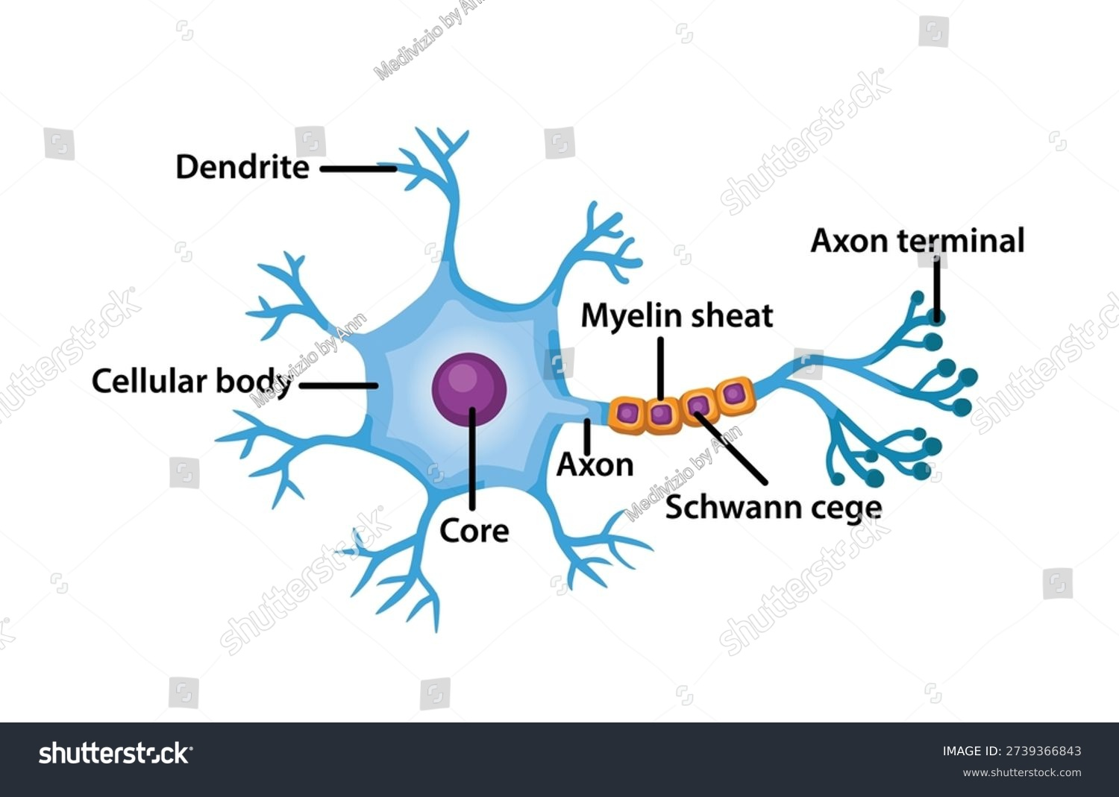
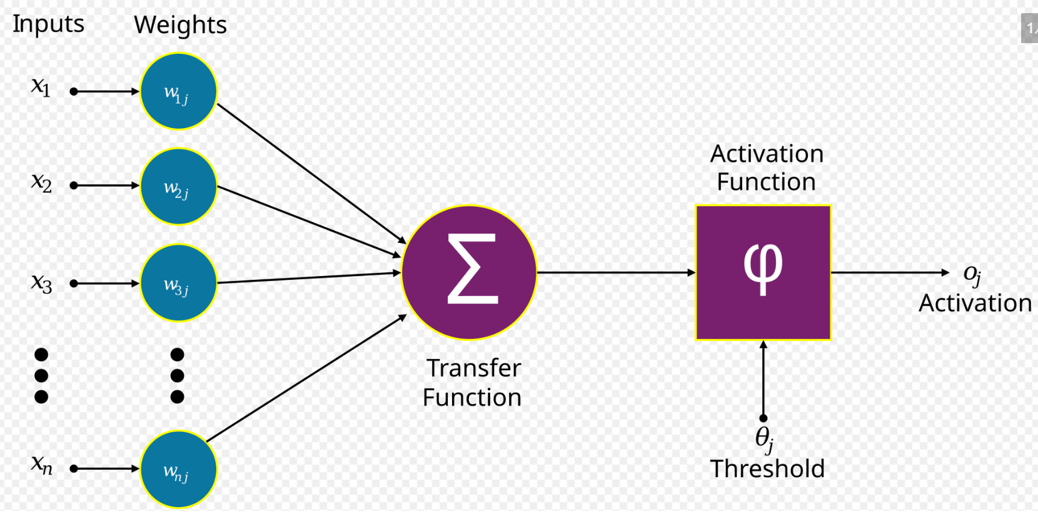
The Biological Inspiration
The Human Neuron:
  Dendrites receive signals
  Cell body processes signals
  Axon transmits output signal
  Synapses are connection points
The Artificial Neuron (Perceptron, 1958):
  Inputs (x₁, x₂, x₃) → Weights (w₁, w₂, w₃) → Sum + Bias → Activation → Output
Analogy
  Each neuron is a voter. Inputs are opinions. Weights are how much we trust each opinion. The neuron "fires" if the weighted sum crosses a threshold.

Slide 13
A Single Neuron — The Math
z = (w₁ × x₁) + (w₂ × x₂) + ... + (wₙ × xₙ) + b
output = activation(z)
Where:
  x = input values
  w = weights (how important each input is)
  b = bias (the threshold for firing)
activation = a non-linear function (ReLU, sigmoid, etc.)
Example: Predicting if you'll like a movie
  x₁ = genre match (0–1), w₁ = 0.8
  x₂ = actor you like (0–1), w₂ = 0.5
  x₃ = runtime < 2hrs (0–1), w₃ = 0.3
  b = -0.5
  If output > 0.5 → "You'll like it"

Slide 14
Activation Functions — Adding Non-Linearity
Function | Formula | Shape | Use Case
Sigmoid | 1/(1+e⁻ˣ) | S-curve, 0 to 1 | Binary classification (output layer)
ReLU | max(0, x) | Flat then linear | Hidden layers (most common today)
Tanh | (eˣ-e⁻ˣ)/(eˣ+e⁻ˣ) | S-curve, -1 to 1 | Hidden layers
Softmax | eˣⁱ/Σeˣʲ | Probability distribution | Multi-class classification output

Slide 15
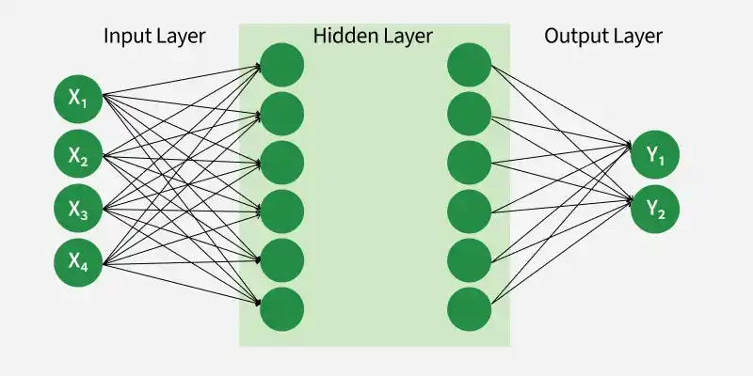
Building a Network — Layers
Input layer: Receives raw data (pixels, words, numbers)
Hidden layers: Extract features and patterns
Output layer: Produces final prediction
Deep Learning = Many hidden layers (hence "deep")

Slide 16
What Happens Inside Hidden Layers?
Layer 1: Detects edges, colors, simple shapes
Layer 2: Combines edges into textures, corners
Layer 3: Combines textures into parts (eyes, wheels, text)
Layer 4+: Combines parts into objects (faces, cars, concepts)
This is feature learning — the network discovers what matters.
Visual analogy:
  Layer 1 = "I see lines"
  Layer 3 = "I see an eye and a nose"
  Layer 5 = "This is a face"

Slide 17
Parameters — The "Memory" of AI
Every connection has a weight. Every neuron has a bias.
Model | Parameters | What This Means
Simple neural net | ~10,000 | Can recognize basic digits
ResNet (image AI) | ~25 million | Recognizes 1,000 object types
GPT-2 (2019) | 1.5 billion | Writes coherent paragraphs
GPT-3 (2020) | 175 billion | General language understanding
GPT-4 (2023) | ~1.8 trillion (estimated) | Multimodal reasoning
GPT-4.5 / Claude 3.5 | Unknown | State-of-the-art performance
Parameters = adjustable knobs the model tunes during training.

Slide 18
Activity — Counting Connections (3 min)
A network has:
  Input layer: 3 neurons
  Hidden layer: 4 neurons
  Output layer: 2 neurons
How many weights?
  (3 × 4) + (4 × 2) = 12 + 8 = 20 weights
How many biases?
  4 + 2 = 6 biases
Total parameters:
  26
Now imagine GPT-4 with ~1.8 trillion parameters. That's why it needs supercomputers.

Slide 19
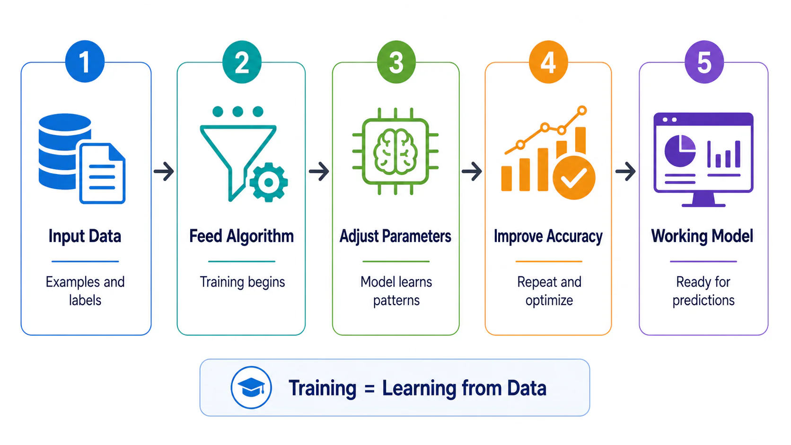
How Training Works — The Big Picture

Slide 20
Step 1 — Forward Pass
Feed input data into the network
Data flows through each layer
Each neuron computes weighted sum + activation
Final layer produces a prediction
Example:
  Input: Image of a dog
  Model output: [0.1, 0.8, 0.1] → probabilities for [cat, dog, bird]
  Model predicts: "dog" (80% confidence)

Slide 21
Step 2 — Calculate the Loss
Loss Function | When Used | Formula Idea
Mean Squared Error (MSE) | Regression (predicting numbers) | Average of (predicted - actual)²
Cross-Entropy Loss | Classification | Penalizes confident wrong answers heavily
Loss Function: Measures how wrong the prediction is.
Example:
  True label: "dog" = [0, 1, 0]
  Prediction: [0.1, 0.8, 0.1]
  Loss = -log(0.8) ≈ 0.22
  If prediction was [0.1, 0.3, 0.6] (confidently wrong):
  Loss = -log(0.3) ≈ 1.20 → much worse

Slide 22
Step 3 — Backpropagation
The Core Innovation (1986): How do we know which weights to change?
Chain Rule from Calculus:
  ∂(Loss) ∂(Loss) ∂(Output) ∂(Weighted Sum)
  ───── =──────── × ──────── × ───────────────
  ∂(w₁) ∂(Output) ∂(Sum) ∂(w₁)
In plain English:
  Calculate how much the loss changes if we tweak the output
  Calculate how much the output changes if we tweak the weighted sum
  Calculate how much the weighted sum changes if we tweak the weight
  Multiply them together → that's how much to change the weight
This flows backward from output to input — hence "backpropagation."

Slide 23
Step 4 — Gradient Descent
Goal: Find the set of weights that minimizes loss.
Analogy: You're blindfolded on a mountain and want to reach the valley (minimum loss).
  Feel the slope under your feet (gradient)
  Take a step downhill (update weights)
  Repeat until flat (convergence)
plain
new_weight = old_weight - learning_rate × gradient
Hyperparameter | What It Controls | Too High | Too Low
Learning Rate | Step size | Overshoot minimum | Training takes forever
Epochs | How many times we see all data | Overfitting | Underfitting
Batch Size | Data per weight update | Noisy updates | Memory issues

Slide 24
The Training Loop — Visualized
Epoch 1: Loss = 2.5 ████████████████████
Epoch 10: Loss = 1.2 ██████████
Epoch 100: Loss = 0.3 ██
Epoch 1000: Loss = 0.05 █
What you're watching: The model slowly "figuring it out."
Signs of good training:
  Training loss decreases steadily
  Validation loss also decreases
  Accuracy improves
Signs of problems:
  Training loss ↓ but validation loss ↑ → Overfitting
  Loss plateaus → Learning rate too low or model too simple
  Loss explodes → Learning rate too high

Slide 25
Modern Architectures — Overview
Neural networks come in different shapes for different jobs:
Architecture | Best For | Key Feature
CNN | Images, video | Local connections, translation invariance
RNN / LSTM | Sequences, time series | Memory of previous inputs
Transformer | Text, everything | Attention mechanism
GAN | Generating images | Two networks competing
Diffusion | Image generation | Gradually denoising random data

Slide 26
CNNs — Convolutional Neural Networks
For: Image recognition, computer vision
The Problem: A 1000×1000 image has 1,000,000 pixels. Fully connected = too many parameters.
The Solution: Convolution
  Slide a small "filter" (e.g., 3×3) across the image
  Each filter detects a feature: edges, corners, textures
  Early layers: simple features. Deep layers: complex objects.
Example filters:
Edge detector: [-1, -1, -1] Blur: [1/9, 1/9, 1/9]
[-1, 8, -1] [1/9, 1/9, 1/9]
[-1, -1, -1] [1/9, 1/9, 1/9]
Famous CNNs:
  LeNet (1998), AlexNet (2012), ResNet (2015)

Slide 27
RNNs — Recurrent Neural Networks
For: Sequences (text, speech, time series, DNA)
The Idea: Process data one step at a time, maintaining a "hidden state" (memory).
Input: "The cat sat..."
  Step 1: "The" → hidden state updates
  Step 2: "cat" → hidden state updates (now knows subject)
  Step 3: "sat" → hidden state updates (now knows action)
Problem: Vanishing gradients — memory fades over long sequences.
Solution: LSTM (Long Short-Term Memory) and GRU gates control what to remember/forget.

Slide 28
Transformers — The Architecture That Changed Everything
Paper: "Attention Is All You Need" (Google, 2017)
The Breakthrough: Instead of processing sequentially, look at ALL words at once and decide which ones matter for each prediction.
Self-Attention Mechanism:
"The cat sat on the mat because it was tired.“
  What does "it" refer to?
  The attention mechanism learns:
    - "it" → "cat" (strong connection)
    - "it" → "mat" (weak connection)
Why it matters: Parallel processing = train on massive datasets = emergent intelligence.

Slide 29
Transformers — Key Components
Tokenization: Break text into tokens (words/subwords)
  "ChatGPT" → ["Chat", "G", "PT"] or similar
Embeddings: Convert tokens to vectors (numbers)
  "king" - "man" + "woman" ≈ "queen"
Multi-Head Attention: Multiple attention patterns simultaneously
  One head tracks grammar
  One head tracks meaning
  One head tracks context
Feed-Forward Layers: Process attended information
Layer Normalization & Residual Connections: Stabilize training

Slide 30
Activity — Attention Visualization (3 min)
Look at this sentence:
"The bank of the river was steep, so I sat on the bank to rest."
Question: In the second "bank," which words should the model pay attention to?
Answer: "river" (to know it's a riverbank, not a financial bank)
This is exactly what self-attention does — it resolves ambiguity by looking at context.

Slide 31
Large Language Models — How ChatGPT Works
Step 1: Pre-training (Self-Supervised Learning)
  Feed the internet (books, Wikipedia, websites)
Task: Predict the next word
Example: "The capital of France is ___" → "Paris"
Result: A "base model" that knows language and facts
Step 2: Fine-Tuning (Supervised Learning)
  Humans write question-answer pairs
Model learns to be helpful, not just predict text
Step 3: RLHF — Reinforcement Learning from Human Feedback
  Humans rank multiple model outputs ("A is better than B")
Model learns human preferences
Result: ChatGPT's conversational, helpful tone

Slide 32
Tokenization — The Secret Language of LLMs
LLMs don't read words. They read tokens.
Key facts:
~100 tokens ≈ 75 words (English)
Context window = how many tokens the model can "see" at once
GPT-4: 128K tokens ≈ 100 pages of text
Why it matters: Token boundaries affect how models understand text.
Text | Tokens (GPT-4 style)
"ChatGPT" | ["Chat", "G", "PT"]
"unbelievable" | ["un", "believ", "able"]
"The" | ["The"]
"🚀" | ["🚀"]

Slide 33
How LLMs Generate Text — Autoregressive Decoding
Prompt: "The weather today is"
Step 1: Predict next token probabilities
sunny: 45%, rainy: 20%, cloudy: 15%, hot: 10%, ...
Step 2: Sample (or pick top probability) → Choose "sunny"
Step 3: Append to sequence: "The weather today is sunny"
Step 4: Repeat → "and", "warm", "."
Final: "The weather today is sunny and warm."
Temperature parameter:
Low (0.1): Always pick highest probability → deterministic, factual
High (1.0+): More random → creative, sometimes nonsensical

Slide 34
Capabilities — What Modern AI Can Do
Reasoning: Solve math problems, debug code, analyze arguments
Creativity: Write stories, compose music, generate art
Translation: Real-time across 100+ languages
Summarization: Distill 100-page documents to bullet points
Coding: Write, explain, and debug software
Multimodal: Understand images, audio, and video alongside text
But remember: It's all next-token prediction at massive scale.

Slide 35
Limitations — What AI Cannot Do
No true understanding: It doesn't "know" — it predicts patterns
No consciousness: No feelings, desires, or subjective experience
No real-world grounding: Hasn't lived, touched, or experienced
No causal reasoning: Correlation ≠ causation
Brittle outside training data: Fails on novel situations
Hallucinations: Confidently makes things up
No common sense: Can fail tasks a 5-year-old solves easily
Critique: AI is a sophisticated pattern-matching engine, not a mind.

Slide 36
Hallucinations — Why AI Makes Things Up
Training data gaps: If the answer isn't in the data, it improvises
Optimization for fluency: Smooth, confident text is rewarded
Ambiguous prompts: Vague questions get vague (or invented) answers
Compounding errors: One wrong token leads to more wrong tokens
Famous examples:
Lawyers citing fake court cases (ChatGPT hallucinated them)
AI inventing scientific papers that don't exist
Confidently wrong answers to factual questions
Mitigation: Retrieval-Augmented Generation (RAG), fact-checking, human oversight.

Slide 37
Bias in AI — The Mirror Problem
AI learns from human data. Humans are biased. Therefore, AI is biased.
Type | Example
Representation bias | Facial recognition worse on darker skin tones
Historical bias | Hiring AI penalizes women for resumes with "women's college"
Measurement bias | Crime prediction based on arrest data (not actual crime)
Aggregation bias | One-size-fits-all medical AI fails on underrepresented groups
Solutions:
  Diverse training data
  Bias auditing and testing
  Human-in-the-loop decisions
  Transparency and explainability requirements

Slide 38
Key Takeaways
AI = pattern recognition at scale, not thinking or consciousness.
Neural networks learn by adjusting billions of weights through backpropagation.
Transformers revolutionized AI by using attention to process context.
LLMs like ChatGPT are autoregressive next-token predictors trained on internet text + human feedback.
AI has real limitations: hallucinations, bias, no true understanding, no common sense.
The future is collaborative: AI augments human intelligence; it doesn't replace it.

Slide 39

Question? haibinz@ieee.org haibinz@nipissingu.ca

